Slide 1
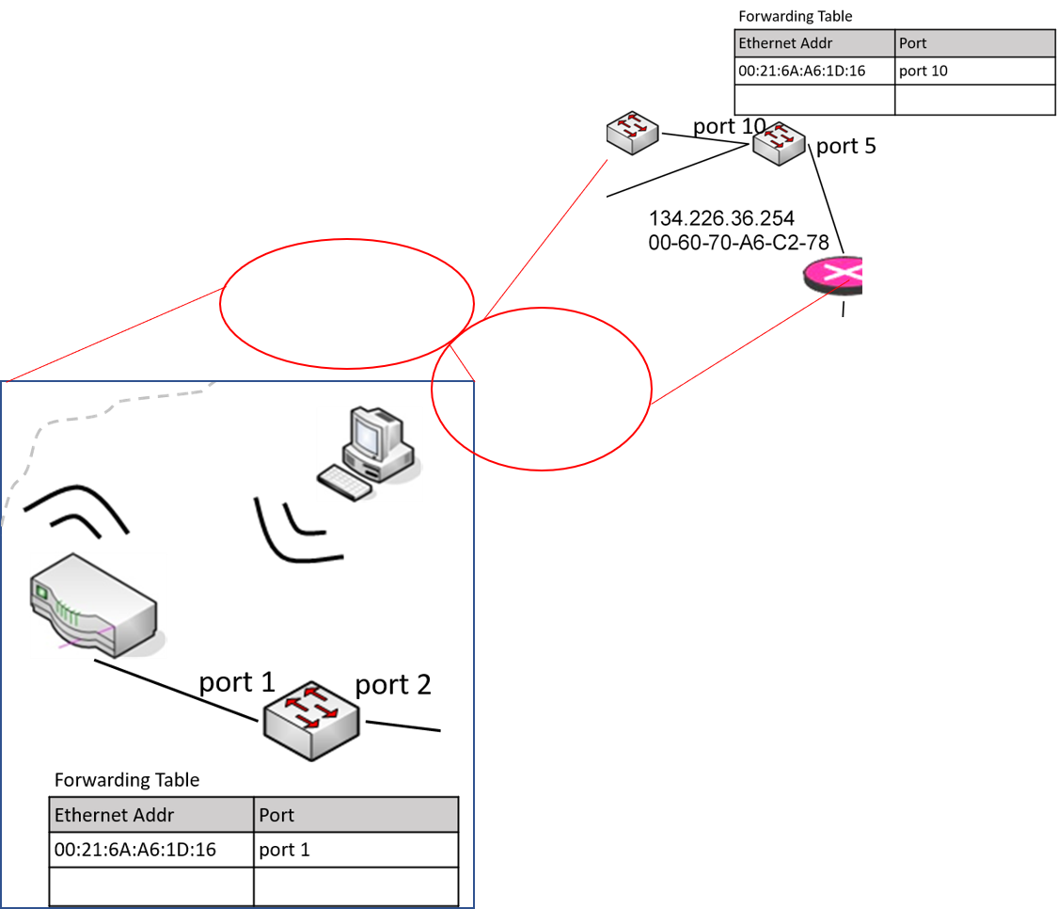

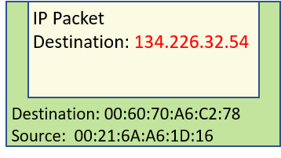
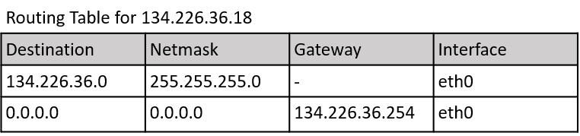
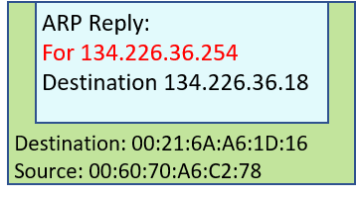
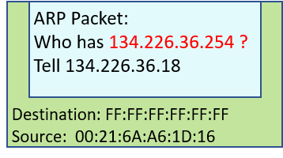
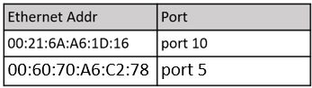
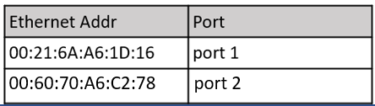
The ARP Reply will travel back from the router to your machine.
Switches will learn the Ethernet address of the router from the ARP reply passing through.
Now your machine can send the IP packet to its default gateway and the switches know how to forward the Ethernet frame.
Your computer wants to sent an IP packet to a node with the IP address 134.226.32.54.
In order to figure out how to get to 134.226.32.54, it will look at its routing table.
From this, it will see that can not get to 134.226.32.54 directly; so, it will have to use the default route.
The gateway for the default route is 134.226.36.254 – from the first route, it knows that it can get to it directly.
Routing Table for 134.226.36.18
Destination | Netmask | Gateway | Interface
134.226.36.0 | 255.255.255.0 | - | eth0
0.0.0.0 | 0.0.0.0 | 134.226.36.254 | eth0
In order to send the IP packet to 134.226.36.254, it will need to create an Ethernet frame to that machine.
To send an Ethernet frame, it will need to know the Ethernet address of 134.226.36.254 – so, it will send an ARP request for this addresss.
Switches will learn your machines Ethernet address as they process the ARP request.
Destination: ??
Source: 00:21:6A:A6:1D:16
IP Packet
Destination: 134.226.32.54
Destination: FF:FF:FF:FF:FF:FF
Source: 00:21:6A:A6:1D:16
ARP Packet:
Who has 134.226.36.254 ?
Tell 134.226.36.18
IP Packet
Destination: 134.226.32.54
This is a broadcast !!

Slide 2
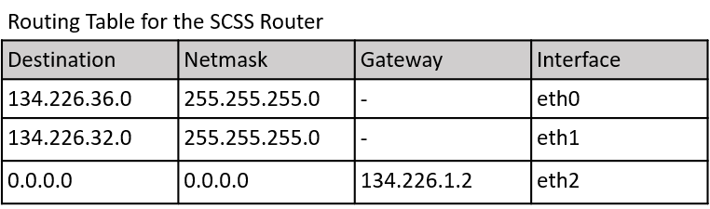
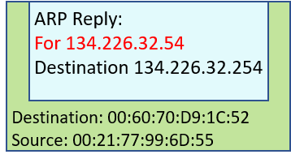
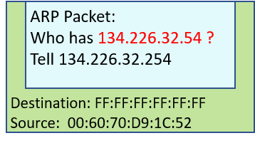
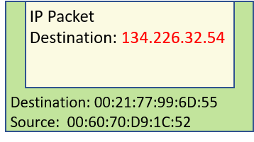
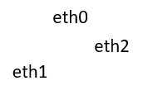
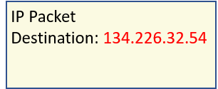
In the next step, the SCSS router needs to decide where to forward the IP packet.
From its routing table, it will find that the subnet 134.226.32.0 is connected to interface eth1.
It will now send an ARP request on this subnet to determine the hardware address for 134.226.32.54.
The switches along the way will learn the hardware address of the router and the proxy will reply with its hardware address.
Now the router can forward the IP packet to the proxy using an Ethernet frame addressed to the proxy’s hardware address.
This is a broadcast !!

Slide 3
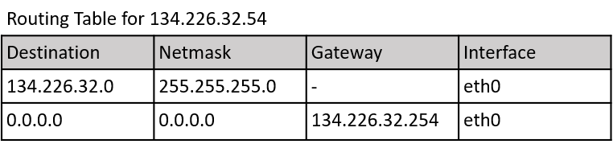
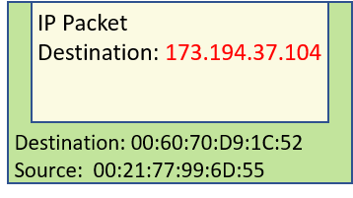
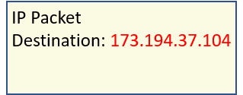
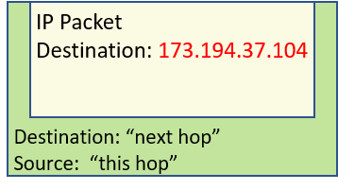
Following the IP packet from your computer, the proxy will send out its own IP packet addressed to 172.194.34.104.
It will send the IP packet embedded in an Ethernet frame to its default router.
The SCSS router will forward the packet to the TCD router. The TCD to a router at HEAnet… and so on.
Every time, the IP packet is forwarded in a an Ethernet frame addressed to the next hop.

